Slide 1
Advanced Networking Lab: Intro to 5G Labs
2023-2024
Johan Bergs, Michael Peeters, Arno Troch

Slide 2
Overview
Lab Structure & What to Expect

Slide 3
Lab Structure
Lab | Timeline
Lab 1: Pre-reading | 15 April – 21 April
Lab 2: Basic Design | 22 April – 28 April
Lab 3: RF Planning | 29 April – 5 May
Deadline Labs 1-3: Sunday, 5 May 2024
Lab 4: Configuring OpenAirInterface | 6 May – 12 May
Lab 5: Running OpenAirInterface | 13 May – 19 May
Lab 6: OpenAirInterface Walk Test | 20 May – 26 May (@ The Beacon)

Slide 4
5G New Radio (NR)
A Short Introduction

Slide 5



5G NR?
User Equipment (UE)
Cell Tower (gNodeB)
Core Network
(CN)

Slide 6
5G NR?
User Equipment (UE)
Cell Tower (gNodeB)
Core Network
(CN)
New Radio (NR)
Radio Access Network (RAN)

Slide 7

OFDM & Numerology
Orthogonal Frequency Division Multiplexing (OFDM)
Split bandwidth into orthogonal subcarriers
Subcarrier Spacing (SCS)
= Space between two subcarriers
Flexible in 5G NR ➔ Numerology
Numerology ($μ$)
Defines SCS (among other things)
µ | SCS (kHz)
0 | 15
1 | 30
2 | 60
3 | 120
4 | 240
5 | 480
6 | 960

Slide 8
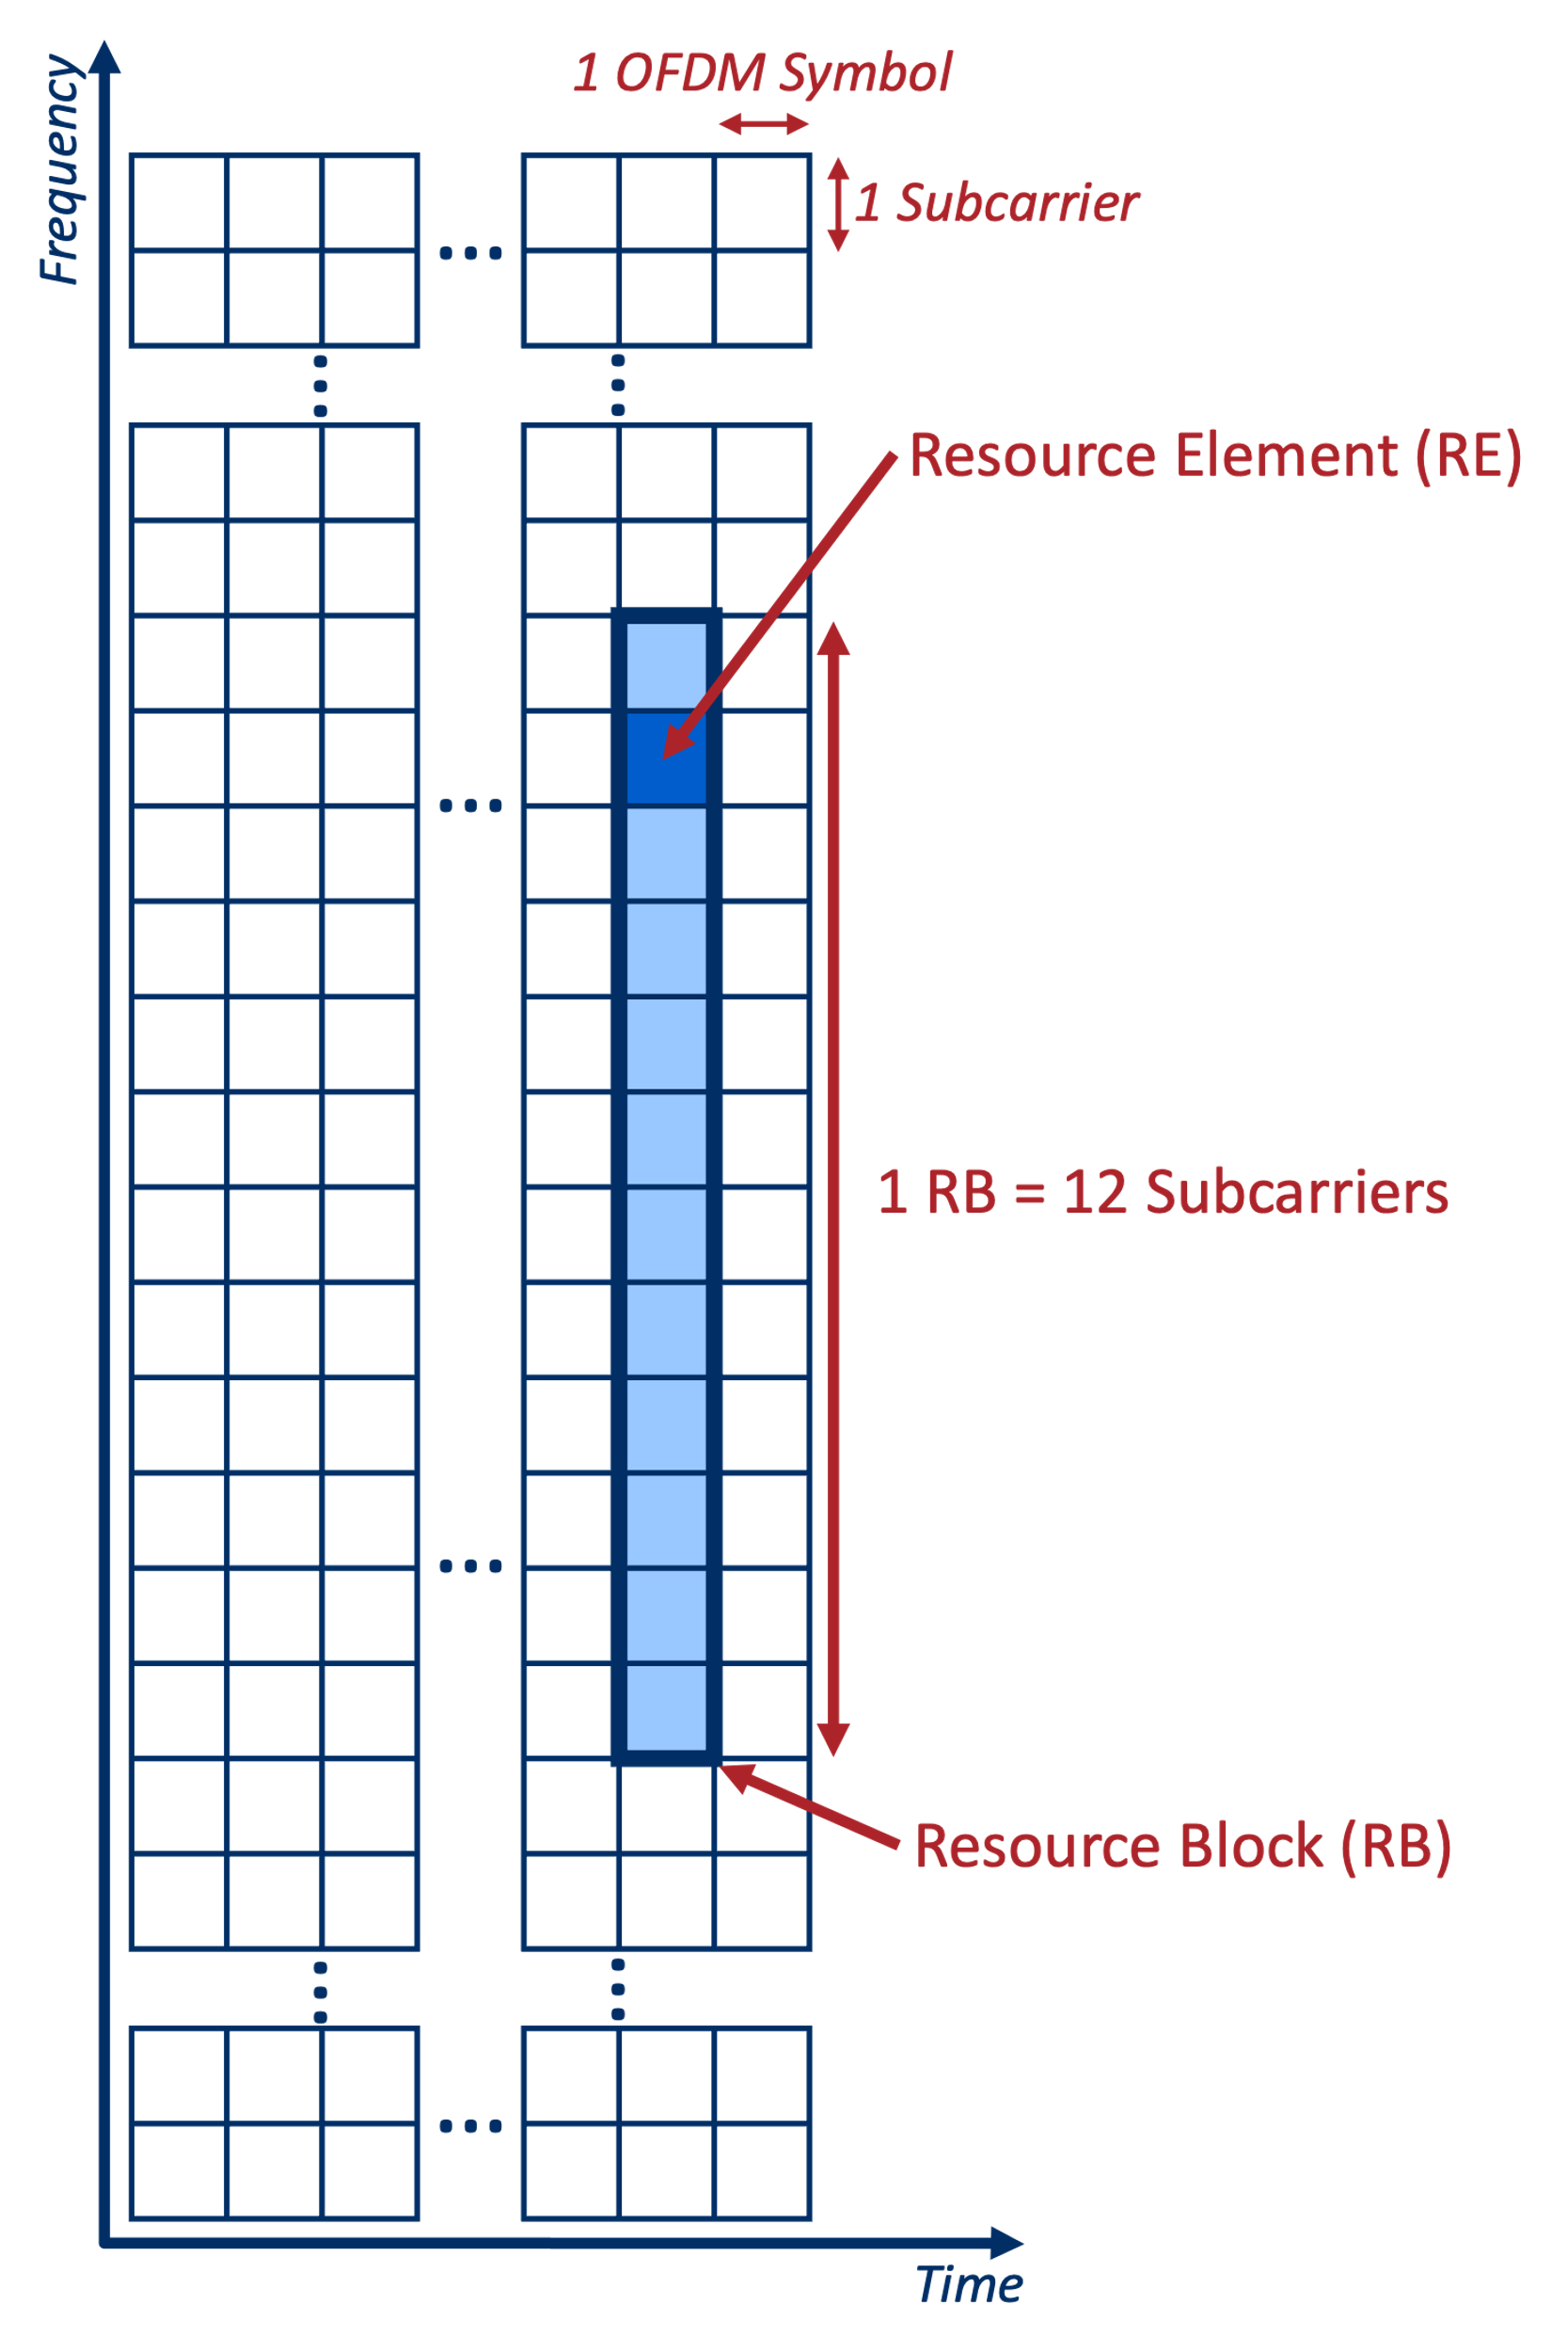
Resource Grid
Important Terms:
Resource Element
Resource Block

Slide 9
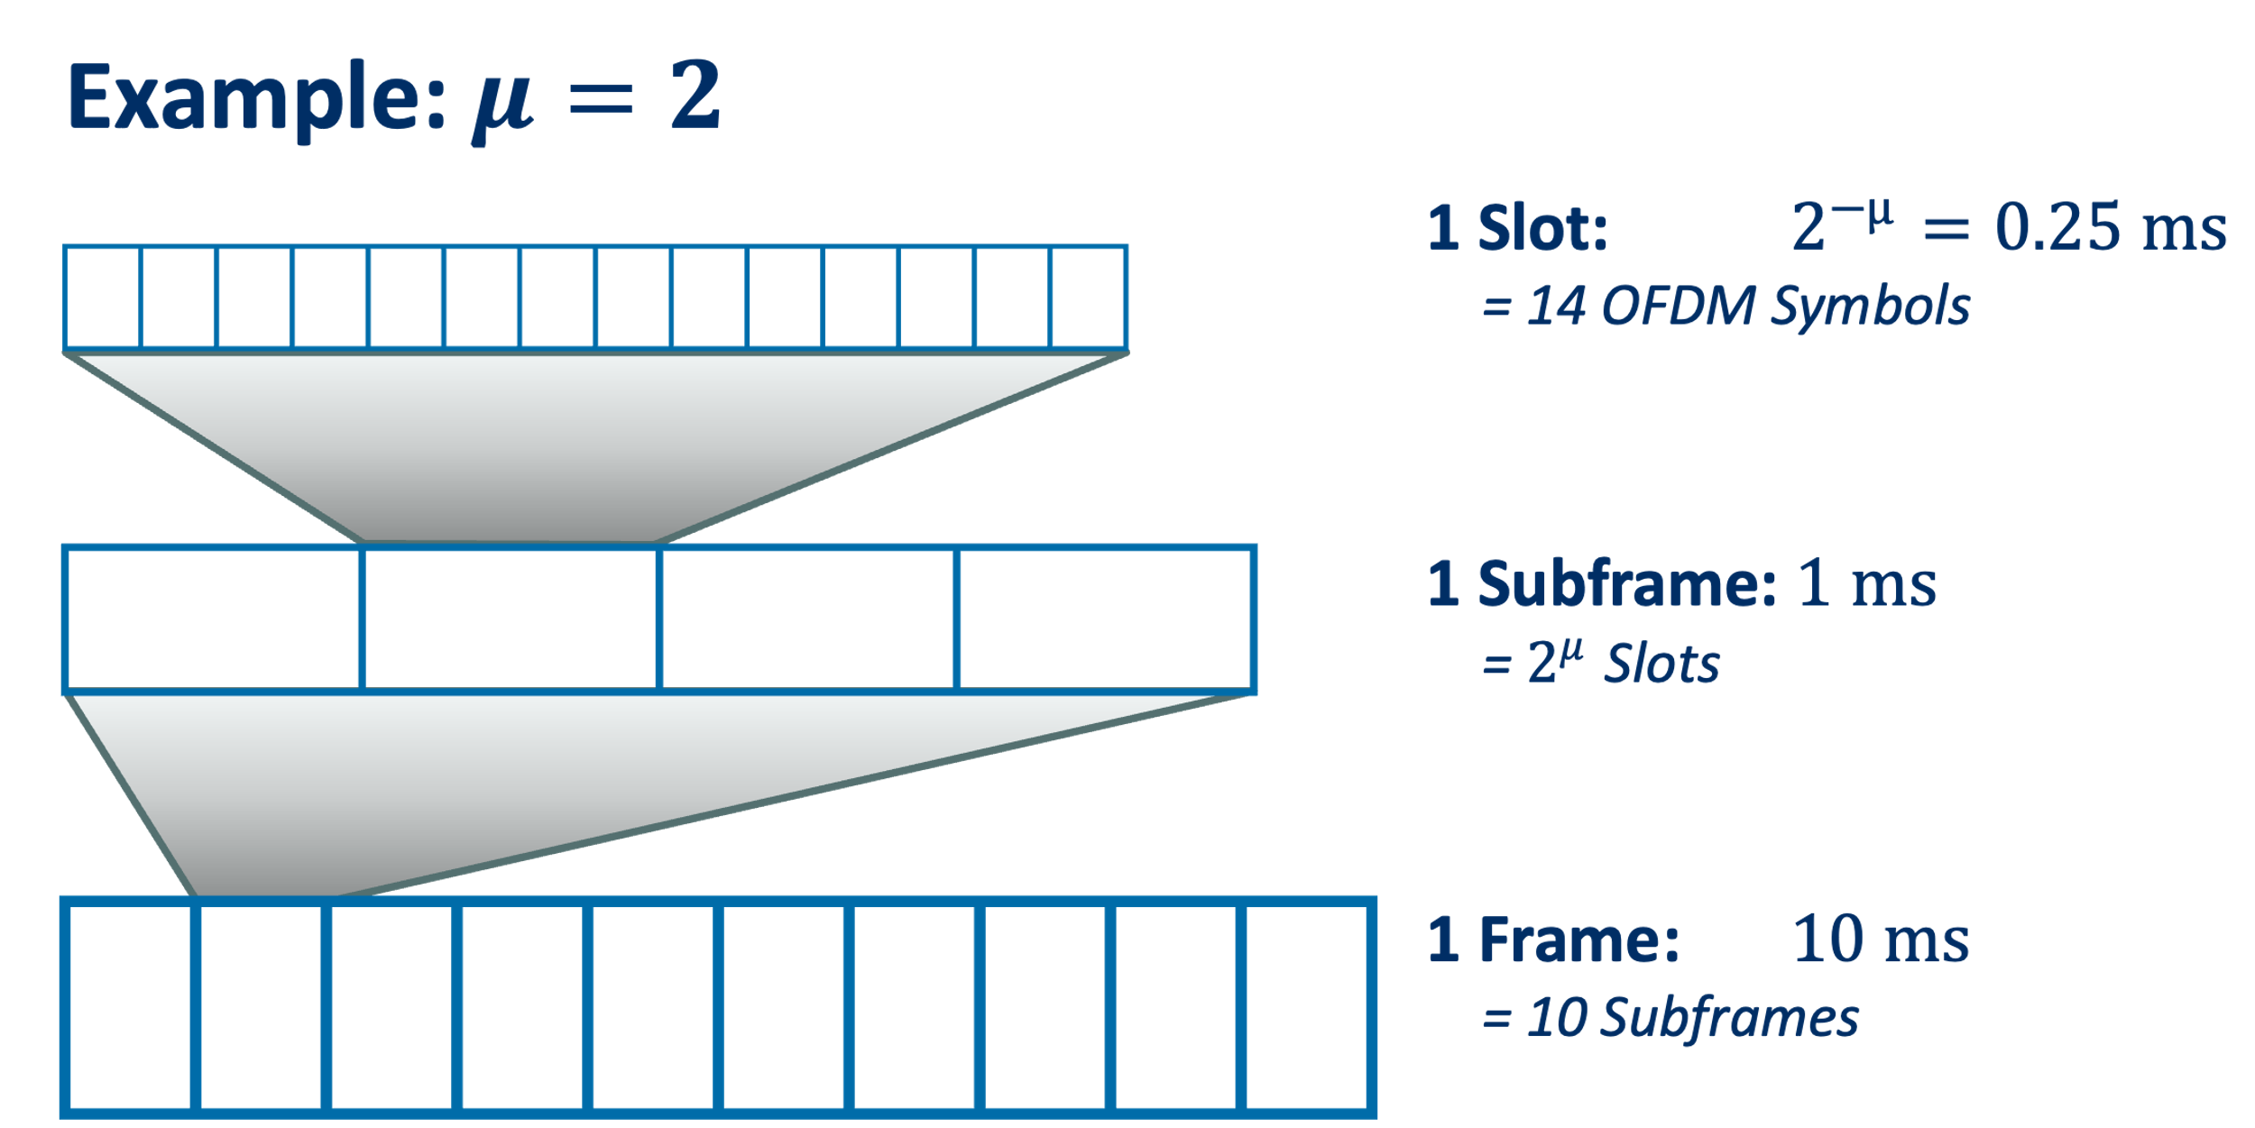
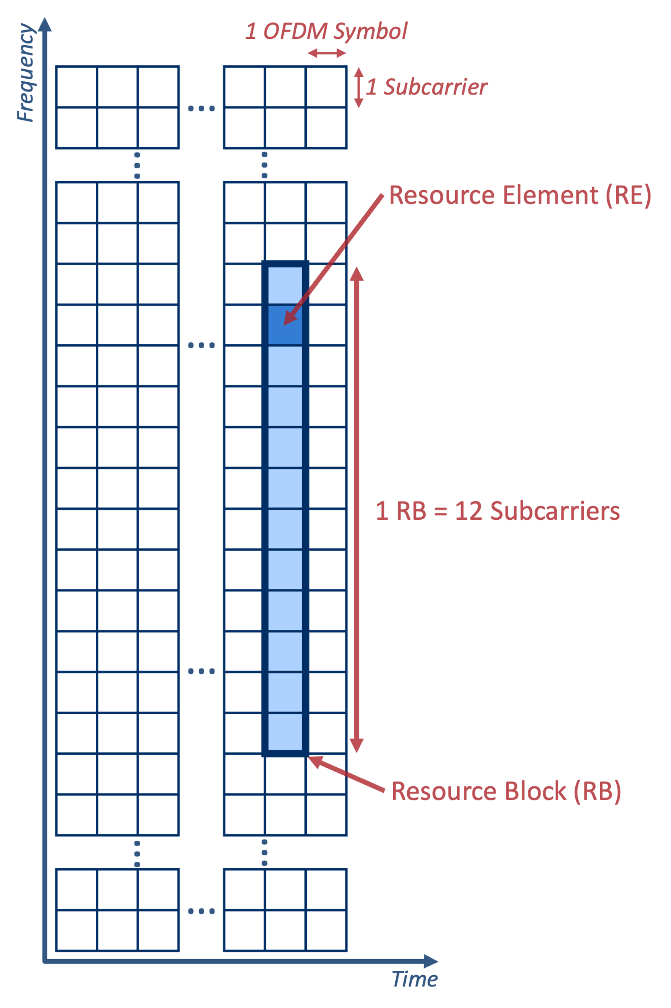
Frame Structure Depends on Numerology
14 OFDM symbols = 1 slot

Slide 10
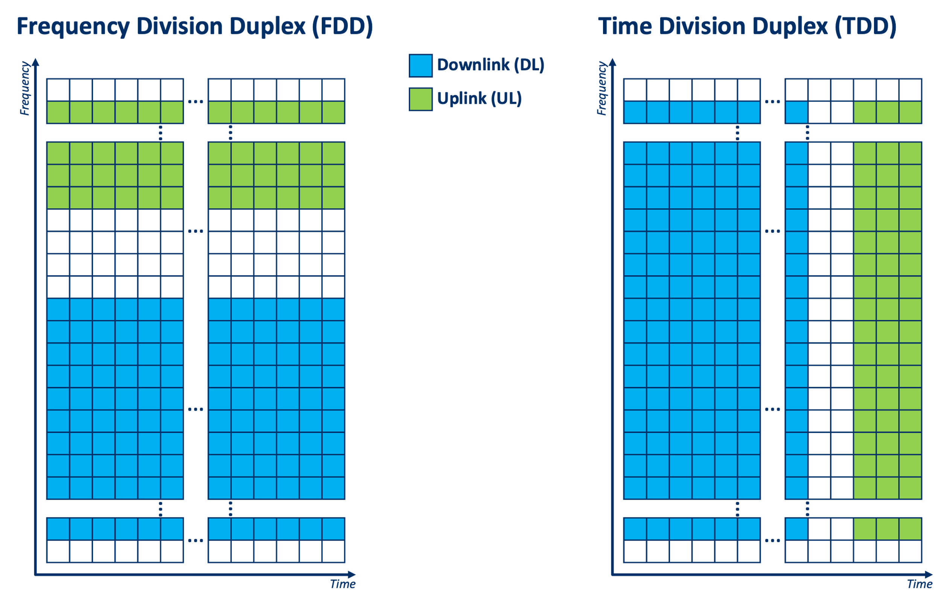
Uplink/Downlink Resource Allocation

Slide 11
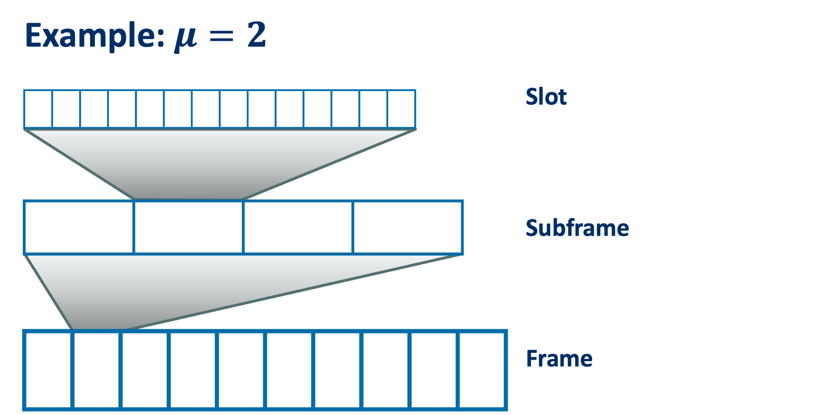
Uplink/Downlink Resource Allocation Back to the Frame Structure
TDD pattern
= repeating sequence of DL/UL slots
Example TDD pattern: DDDSU

